Slide 1






﻿
﻿
﻿
﻿
﻿
﻿
﻿
﻿
﻿
﻿
﻿
﻿
Supporting safe and effective care across the Capital and beyond
Introduction to the London Care Record for health and care professionals
Updated 5th March 2024
Local Logo Placeholder

Slide 2

﻿
﻿
﻿
﻿
What is the London Care Record?
The London Care Record gives you, and other health and care professionals, instant access to the information you need about a person at the point of care.
It is an up-to-date record of their information over time and across different parts of the NHS and social care.
This joined-up information helps you provide the best possible care and can save you valuable time.
The London Care Record is a summary view of an individual’s health and care record all in one place.
Information in the London Care Record is read-only and cannot be changed.
In most cases information is up to date as it is relayed directly from the original record.
You can easily and instantly access it through your organisation’s own electronic record system and do not need a separate login or password.
The London Care Record uses technology called the Cerner Health Information Exchange so in some systems it might be labelled ‘HIE’.

Slide 3
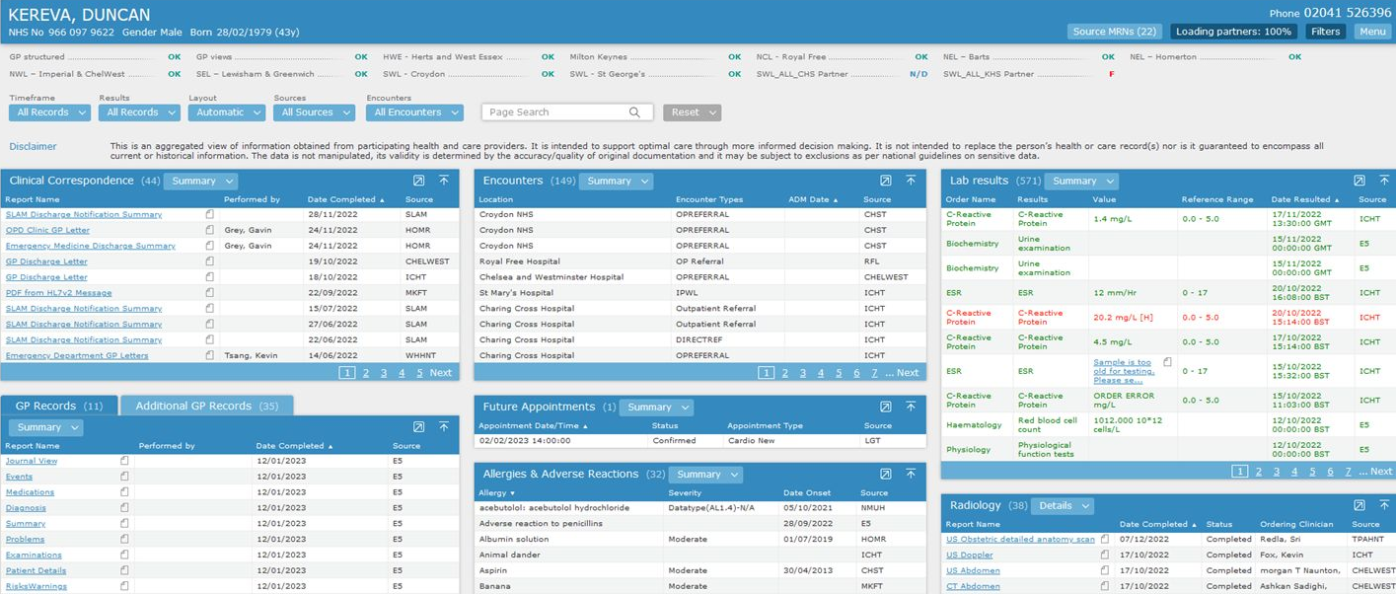
﻿
﻿
﻿
The London Care Record
This is test patient data.

Slide 4
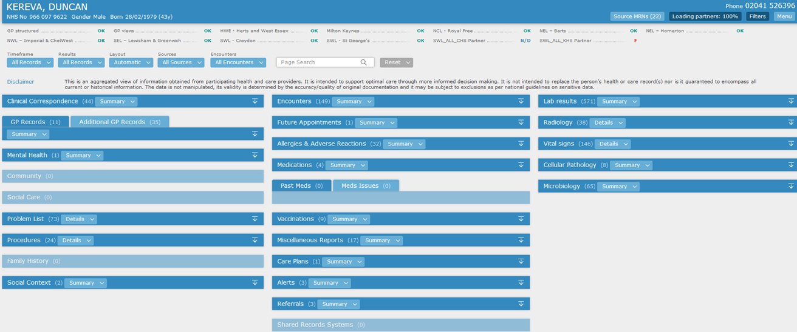
﻿
﻿
﻿
Finding the information you need
Information is shown in sections (also called pods/widgets)
Some show lists of related items pulled from more than one place. Some sources, such as GP records, have their own section. The same type of information i.e. medications will therefore be found in more than one section.
These can be easily re-ordered by dragging and dropping and expanded or collapsed. This creates a personalised view of the LCR.
Information is shown in chronological order and can be sorted or filtered by date or source organisation
This is test patient data.

Slide 5
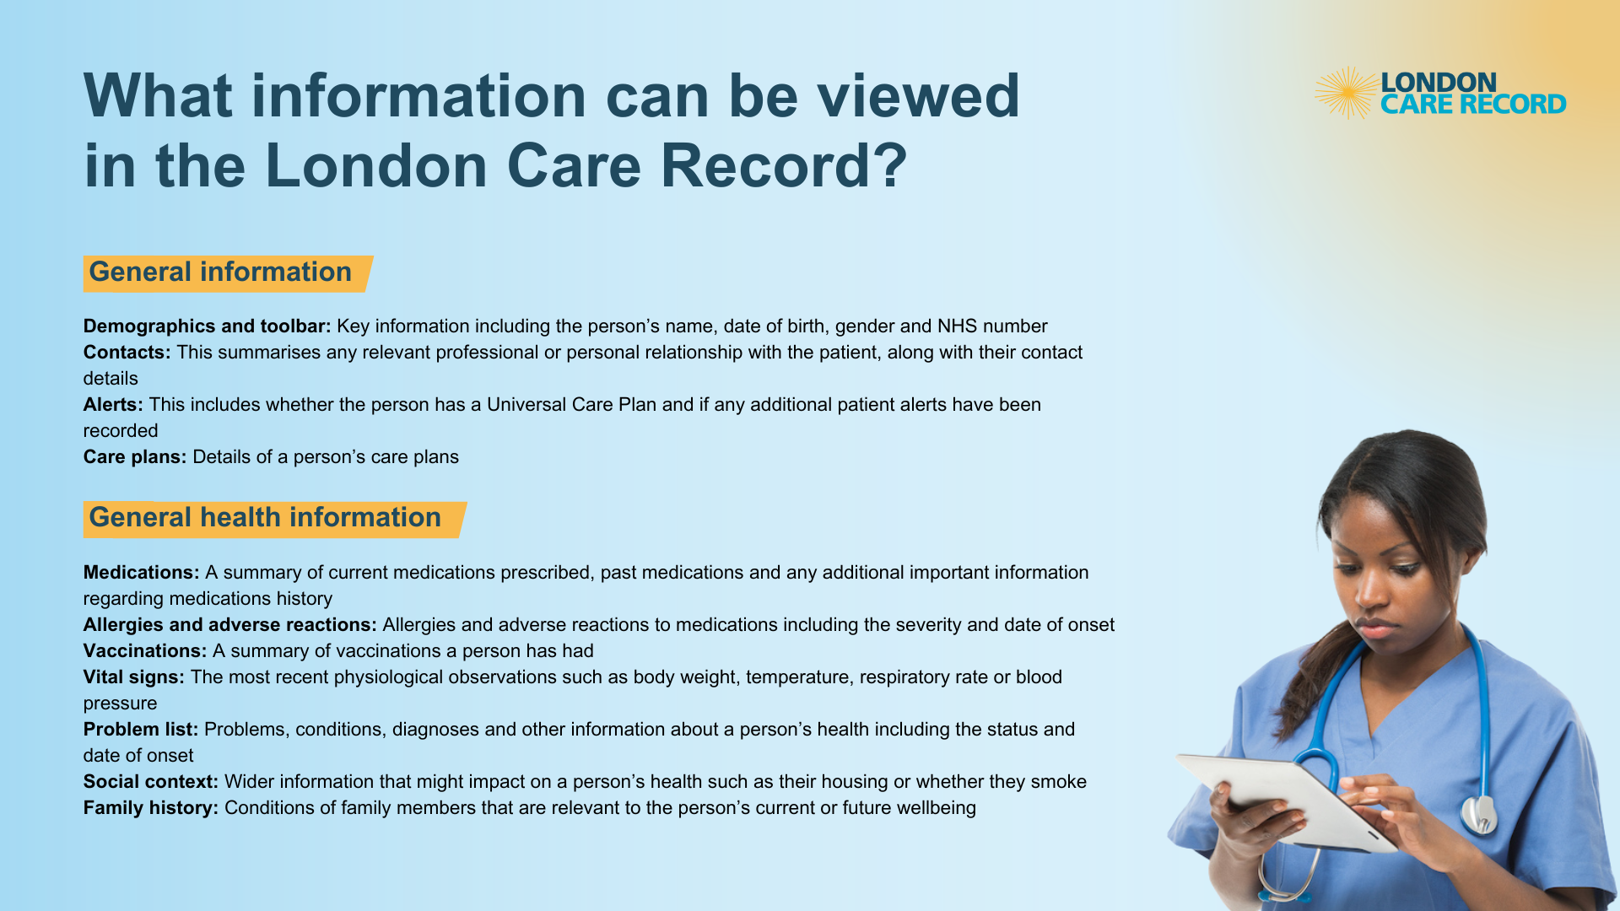
The London Care Record is a read-only summary of selected data. The information
available will differ between organisations. It is not the full record for an individual.

Slide 6
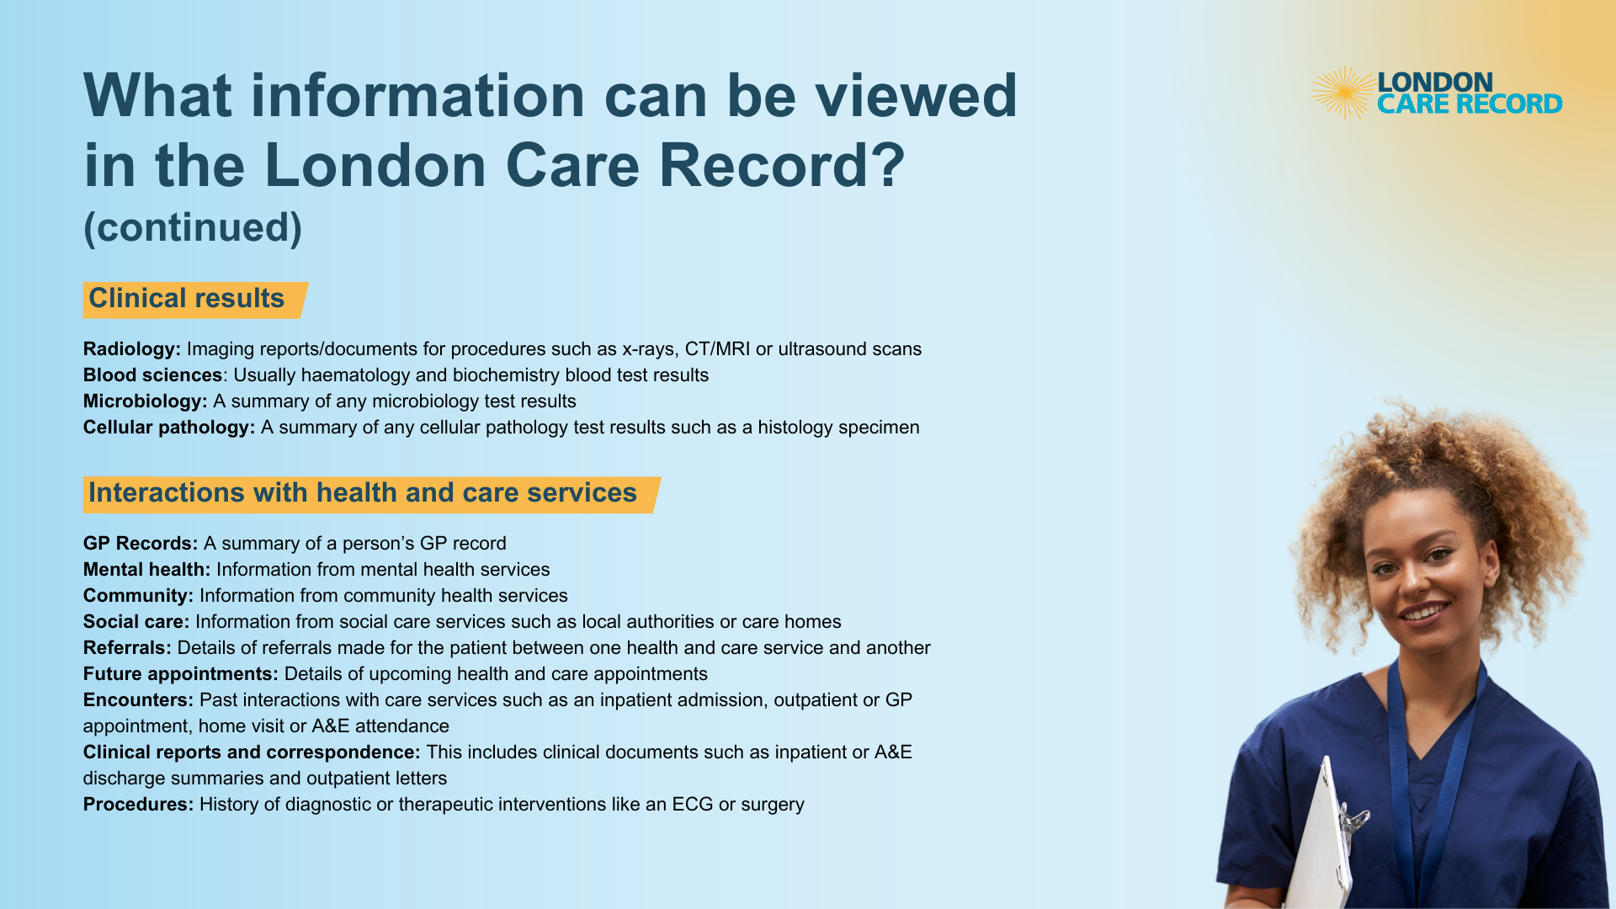

Slide 7








﻿
﻿
﻿
﻿
﻿
Current London Care Record Partners
The London Care Record securely brings information together from London’s five Integrated Care Systems (ICS) as well as Hertfordshire and West Essex ICS and Milton Keynes University Hospitals.
It allows different health and care providers from across London and its surrounding areas to view it.
You can find an up-to-date list of health and care organisations who share information in the London Care Record here

Slide 8


﻿
﻿
﻿
﻿
﻿
﻿
﻿
Patients and Service Users
Secure sharing of information between health and care services is essential for safe and effective care.
The London Care Record can be used whenever you are providing care for an individual. It is not an individual’s full health record, rather a summary of information that is useful to you at the point of care.
While you do not need to ask a person’s consent to view their information in the London Care Record it is important to be transparent and inform them that you are accessing their record whenever possible.
People can choose to object to their information being shared for direct care. It is important to make sure that they understand that not providing access to their records may affect the care they receive.
If they do wish to object, they should be advised to contact the person providing care to them at each organisation who holds records about their care. Each organisation will have their own process to manage objections.

Slide 9



﻿
﻿
﻿
﻿
﻿
﻿
﻿
﻿
﻿
﻿
﻿
What difference does the London Care Record make?
“When patients are transferred to our stroke unit, our stroke team can immediately see what investigations have already been carried out and can access the results.”
Consultant Geriatrician
“The wide range of information in the London Care record is just fantastic, especially for those working in urgent care. And it is all available at a click of a link 24/7.”
ED Consultant
“By accessing the London Care Record I could see patient’s full MRI results. This information changed my management plan of the patient who needed urgent assistance due to the severe pain.”
Clinician
“I can see quickly if a safeguarding assessment has been carried out by social care services, and if not, I can make an immediate referral.”
GP

Slide 10
﻿
﻿
﻿
﻿
﻿
What difference does the London Care Record make?
“It helps me to quickly find out which hospital or ward …how many times they have been admitted and why, as well as their discharge summary. This helps ensure all health partners are working together to complete a safe discharge.”
Hospital Discharge Officer
“In pre-assessment the care is improved, more time spending with patients, less time chasing results as they are obtainable in the London Care Record.”
Specialist Nurse
“I was able to give him the best support and treatment and freed up an ambulance to treat patients elsewhere.”
Advanced Clinical Practitioner
“Having access to pathology investigations that the hospital has done means that duplication is avoided.”
GP

Slide 11
﻿
﻿
﻿
﻿
﻿
﻿
﻿
Further information and contact details
Find out more about the London Care Record here
You can contact the London Care Record Team by emailing enquiries.onelondon@nhs.net
Find out more about how the London Care Record is used at your organisation here:
PLACEHOLDER FOR LOCAL CONTACT DETAILS
Local Logo Placeholder

